Slide 1

8th Grade Math: Pre-Algebra
Unit 7, Lesson 8 Writing Equations of Linear Relationships Volume 1, pg. 322

Slide 2


Benchmarks
MA.8.AR.3.2
Given a table, graph, or written description of a linear relationship, determine the slope.
MA.8.AR.3.3
Given a table, graph or written description of a linear relationship, write an equation in slope-intercept form.
volume 1, pg. 322

Slide 3
Integrated Mathematical Thinking and Reasoning Standards
MA.K12.MTR.4.1 Engage in discussions that reflect on the mathematical thinking of self and others.
MA.K12.MTR.5.1 Use patterns and structure to help understand and connect mathematical concepts.
volume 1, pg. 322

Slide 4

Learning Targets
I can write the equation of a linear relationship in slope‑intercept form given a graph or a table of values.
I can determine the slope of a line from a graph or a table, given a mathematical context.
volume 1, pg. 322

Slide 5

Warm-Up
volume 1, pg. 322

Slide 6

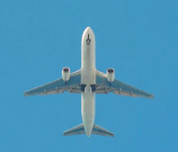
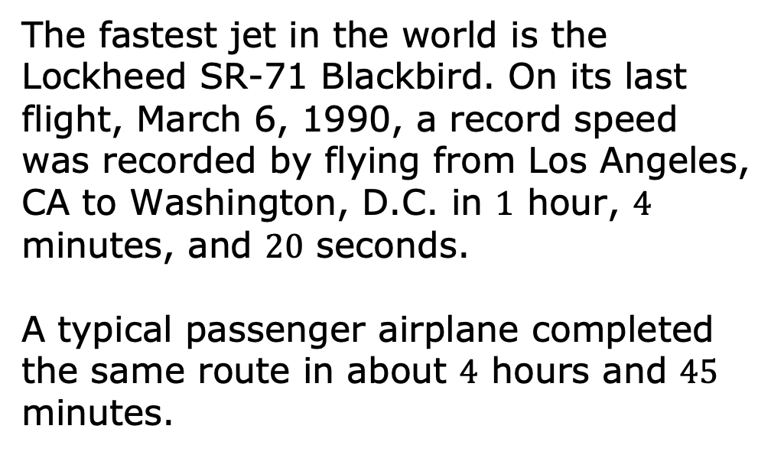
7.8.1 Warm-Up: The Need for Speed
The fastest jet in the world is the Lockheed SR-71 Blackbird. On its last flight, March 6, 1990, a record speed was recorded by flying from Los Angeles, CA to Washington, D.C. in $1$ hour, $4$ minutes, and $20$ seconds.
A typical passenger airplane completed the same route in about $4$ hours and $45$ minutes.
volume 1, pg. 322

Slide 7
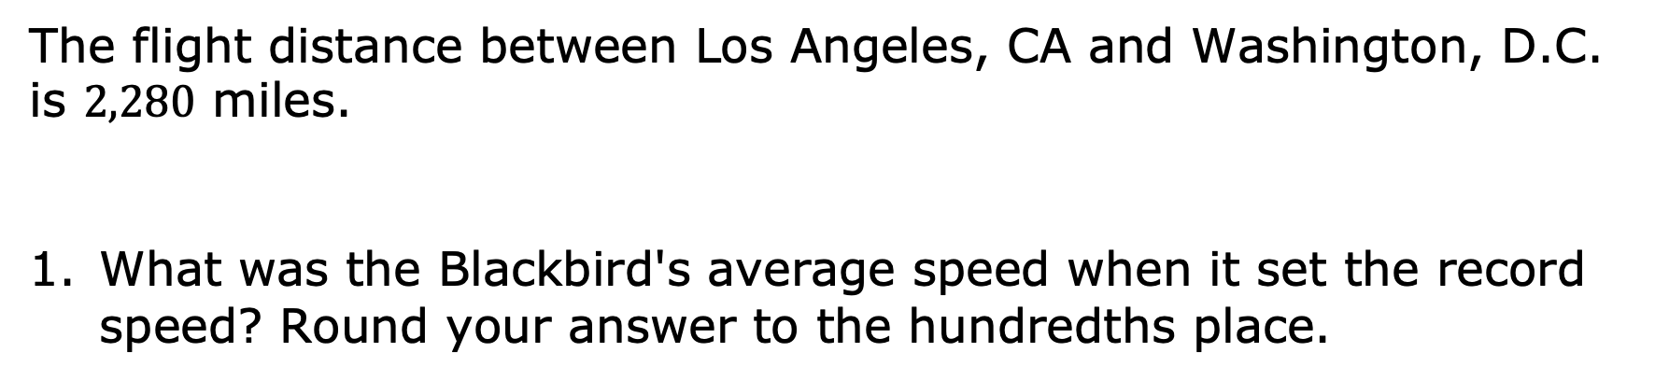
The flight distance between Los Angeles, CA and Washington, D.C. is $2,280$ miles.
What was the Blackbird's average speed when it set the record speed? Round your answer to the hundredths place.
volume 1, pg. 322

Slide 8

Guided Practice
volume 1, pg. 323

Slide 9

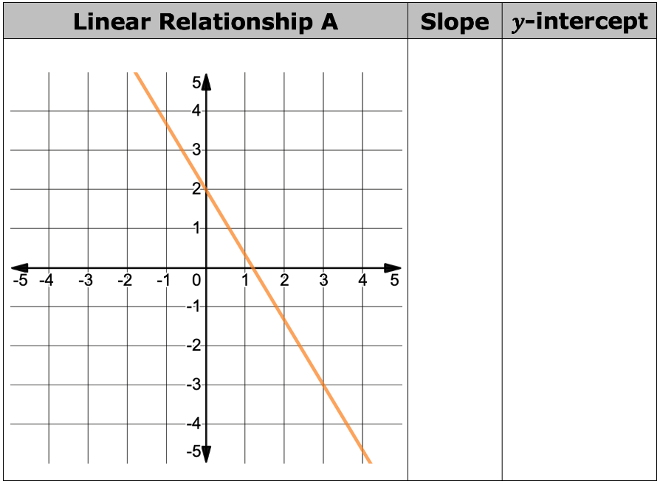
7.8.2 Guided Practice: Writing the Equation of a Linear Relationship
For each linear relationship shown, work with your partner to determine the slope and 𝑦-intercept of the line.
volume 1, pg. 323

Slide 10
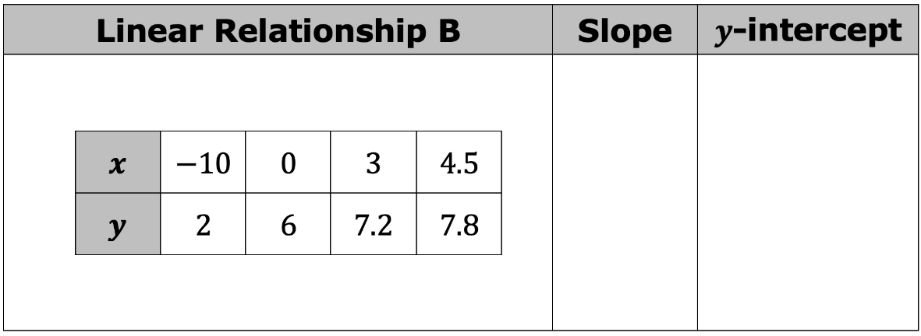
volume 1, pg. 323

Slide 11
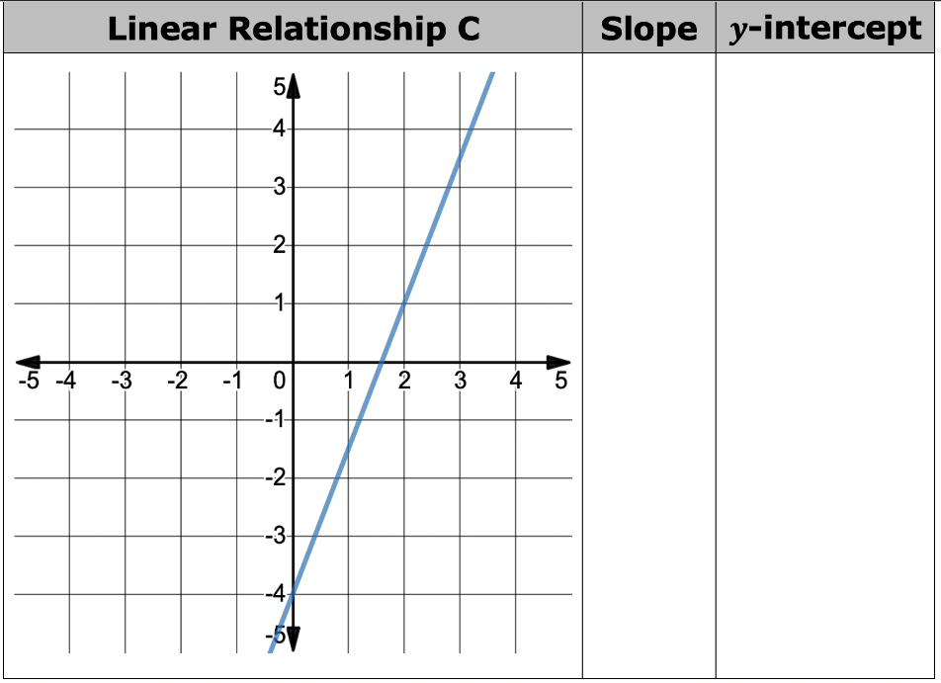

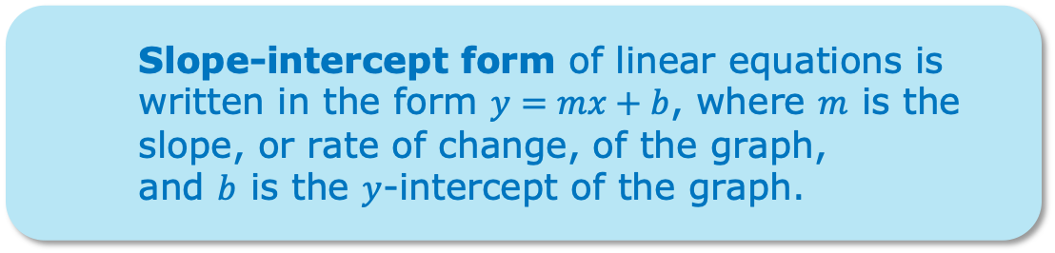
Slope-intercept form of linear equations is written in the form $y=mx+b$, where $m$ is the slope, or rate of change, of the graph,
and $b$ is the $y$-intercept of the graph.
volume 1, pg. 323

Slide 12
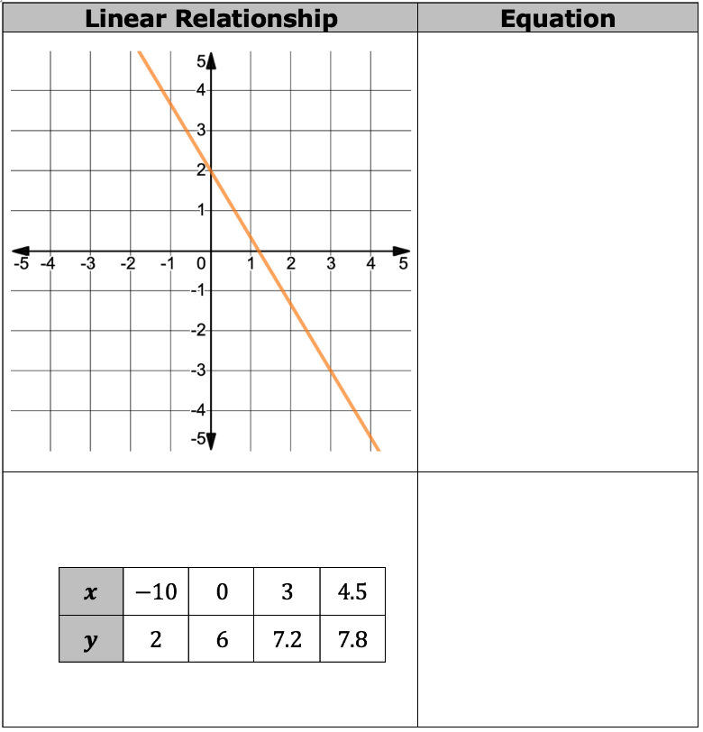
Use the slope and 𝑦-intercept for each linear relationship to write the equation of each line in slope-intercept form.
volume 1, pg. 324

Slide 13
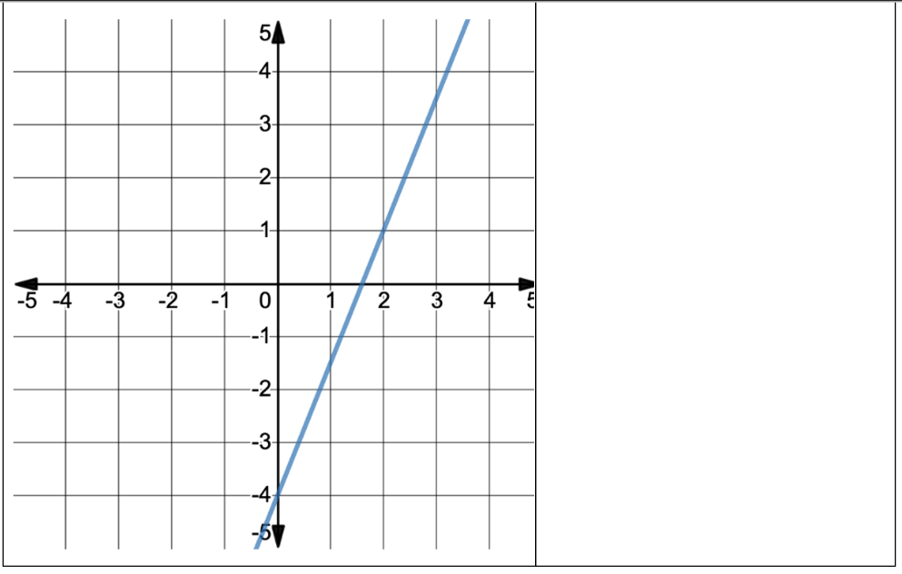
volume 1, pg. 324

Slide 14

Activity
volume 1, pg. 325

Slide 15

7.8.3 Activity: Gallery Walk
Several students wrote equations to represent linear relationships given as tables or graphs, but each student made at least one error.
With your partner or small group, complete the table by analyzing each student’s work to identify their error(s). Then write the correct equation for each linear relationship.
volume 1, pg. 325

Slide 16
Student’s Name | What error(s) did they make? | Correct Equation
Sophia
Austin
Caleb
Hailey
volume 1, pg. 325

Slide 17

Your Turn
volume 1, pg. 325

Slide 18

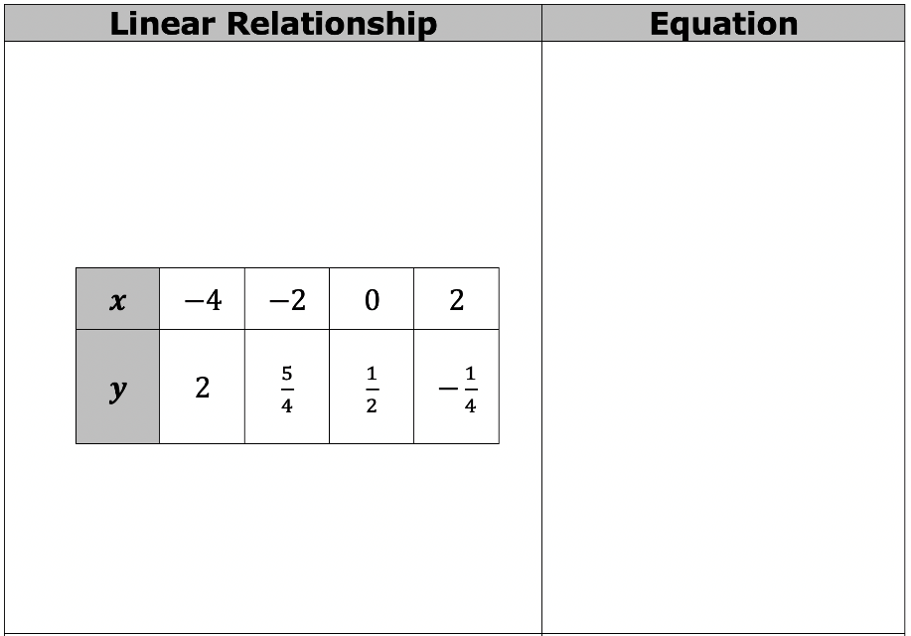
7.8.4 Your Turn!
Write the equation of each line in slope-intercept form.
volume 1, pg. 325

Slide 19
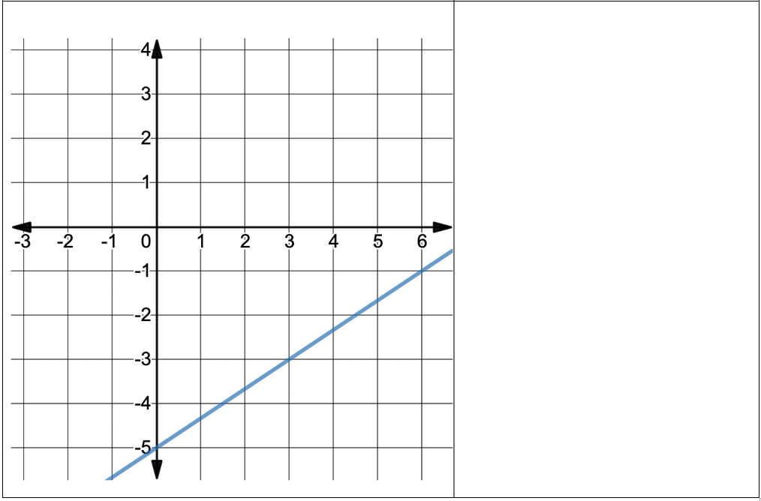
volume 1, pg. 325

Slide 20

Wrap-Up
volume 1, pg. 326

Slide 21
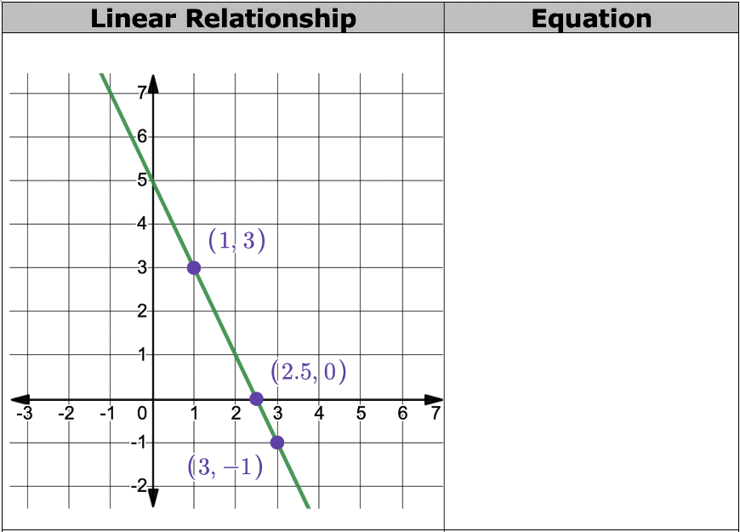
7.8.5 Wrap-Up: Ticket Out the Door
The graph and table each represent linear relationships. Write the equation of each line in slope-intercept form.
volume 1, pg. 326

Slide 22
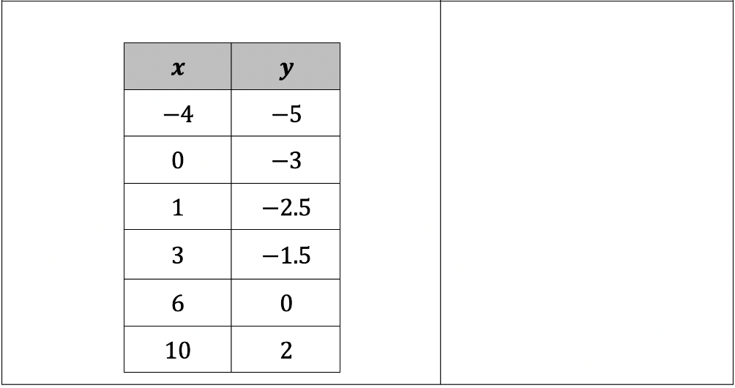
volume 1, pg. 326

